Slide 1
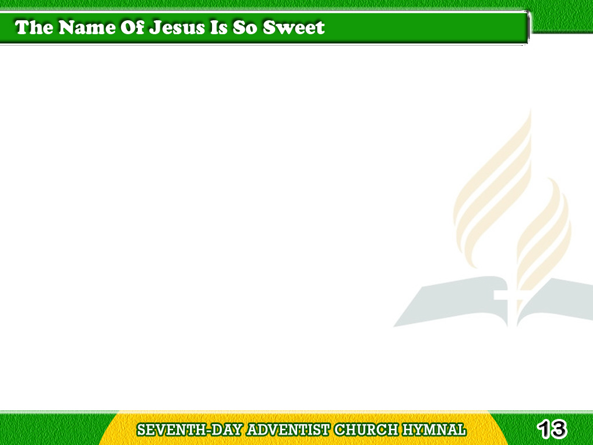
1/4
The name of Jesus
is so sweet,
I love its music to repeat;
Tagalog
Version

Slide 2
1/4
It makes my joys
full and complete,
The precious name of Jesus.
Tagalog
Version

Slide 3
1/4
-Refrain-
“Jesus,” oh, how sweet
the name!
“Jesus,” every day the same;
Tagalog
Version

Slide 4
1/4
Chorus
“Jesus,” let all saints
proclaim
Its worthy praise forever.
Tagalog
Version

Slide 5
2/4
I love the name of Him
whose heart
Knows all my griefs
and bears apart;
Tagalog
Version

Slide 6
2/4
Who bids all anxious
fears depart
I love the name of Jesus.
Tagalog
Version

Slide 7
2/4
-Refrain-
“Jesus,” oh, how sweet
the name!
“Jesus,” every day the same;
Tagalog
Version

Slide 8
2/4
Chorus
“Jesus,” let all saints
proclaim
Its worthy praise forever.
Tagalog
Version

Slide 9
3/4
That name I fondly love
to hear,
It never fails my heart
to cheer,
Tagalog
Version

Slide 10
3/4
Its music dries the
falling tears;
Exalt the name of Jesus.
Tagalog
Version

Slide 11
3/4
-Refrain-
“Jesus,” oh, how sweet
the name!
“Jesus,” every day the same;
Tagalog
Version

Slide 12
3/4
Chorus
“Jesus,” let all saints
proclaim
Its worthy praise forever.
Tagalog
Version

Slide 13
4/4
No word of man
can ever tell
How sweet the name
I love so well;
Tagalog
Version

Slide 14
4/4
Oh, let its praises
ever swell,
Oh praise the name
of Jesus.
Tagalog
Version

Slide 15
4/4
-Refrain-
“Jesus,” oh, how sweet
the name!
“Jesus,” every day the same;
Tagalog
Version

Slide 16
4/4
Chorus
“Jesus,” let all saints
proclaim
Its worthy praise forever.
Tagalog
Version

